Slide 1
Vertical Flame Propagation (VFP)
Triennial Conference on Cabin and Fire Safety
Tina Emami and Rick Whedbee
October 28-31, 2019

Slide 2


Test Development Background
Previous testing has indicated current requirements for materials in hidden areas are not adequate in evaluating fire propagation potential when exposed to a moderately sized hidden fire
Current requirements only address thermal acoustic insulation in inaccessible areas (Radiant Panel Test)
A threat-based lab-scale test method is desired to more closely represent the fire threat for wiring, ducting, and a non metallic fuselage structure

Slide 3
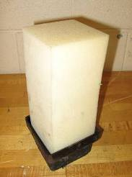
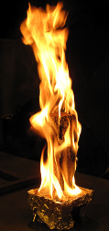
Objectives
The need was demonstrated to test composite structure components and other non-metallic, extensively used parts in inaccessible areas. These include:
  Composite Fuselage
  Wiring / Sleeving
  Ducting
The parameters of the test were developed through realistic full scale tests.
Hidden Area Fire Source – 4”x4”x9” polyurethane foam block

Slide 4
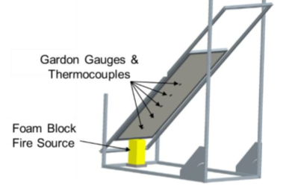
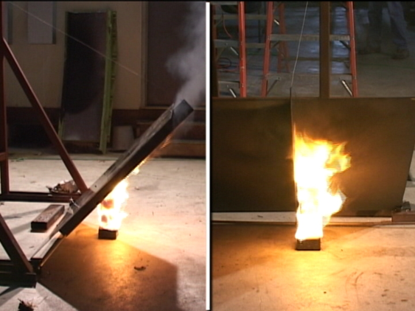
Development of New Flammability Test
Additional scaled tests were conducted based on realistic threats
The foam block fire source was characterized by measuring the heat flux gradient along an insulated board for the duration of the foam burning event
This heat flux gradient was used as the basis to develop a small scale test apparatus

Slide 5
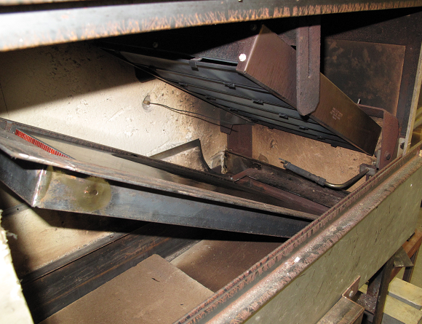
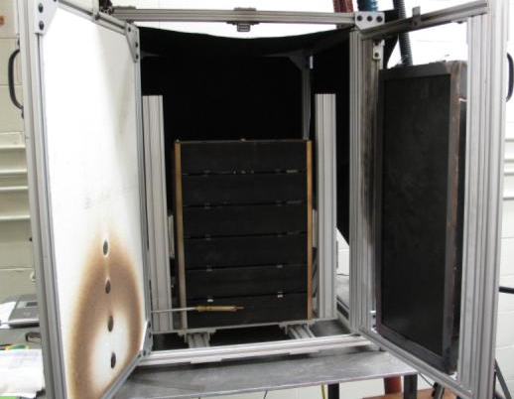
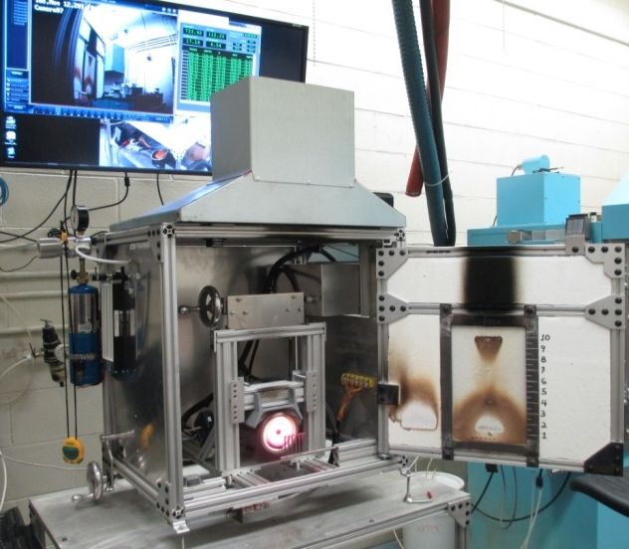
Iterative Test Method Development
Modified T/A Insulation RP
Vertical Radiant Panel
Vertical Radiant Furnace
Large sample size
Sample parallel to RP in order
to get more severe condition
Pre-heat time required to
correlate results to foam block
Vertically mounted radiant panel heater identical to T/A panel
Vertically mounted sample, 12” x 24”
Same pilot torch from T/A test
Pilot too severe, non-uniform in this orientation
Replaced radiant panel with modified NBS coil furnace
Replaced pilot torch with uni-directional multi-flamelet pilot similar to NBS smoke chamber
Monitoring and control of furnace Voltage, Current
Enclosed chamber, added hood
Reduced sample size to 6”x12”

Slide 6
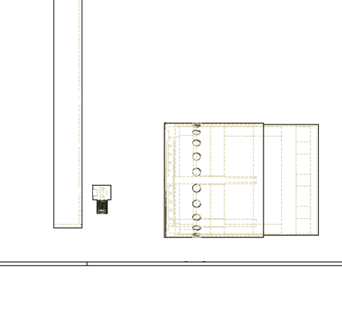

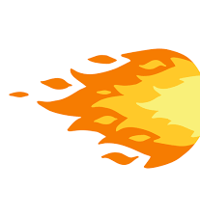
Basic Components of the Test
An electric coil radiant heater is mounted vertically and opposite a 6-inch by 12-inch sample
A methane/air ribbon burner impinges on the lower portion of the test sample, initiating material combustion while continuously exposed to the radiant heat flux from the heater
The burner flame is translated away from the test sample at a pre-determined time (currently 30 seconds)
The test is allowed to continue until all material combustion has ceased
The sample is then removed from the test frame and a post test burn length measurement is made
Test
Sample
Radiant Heater
Ribbon Burner

Slide 7
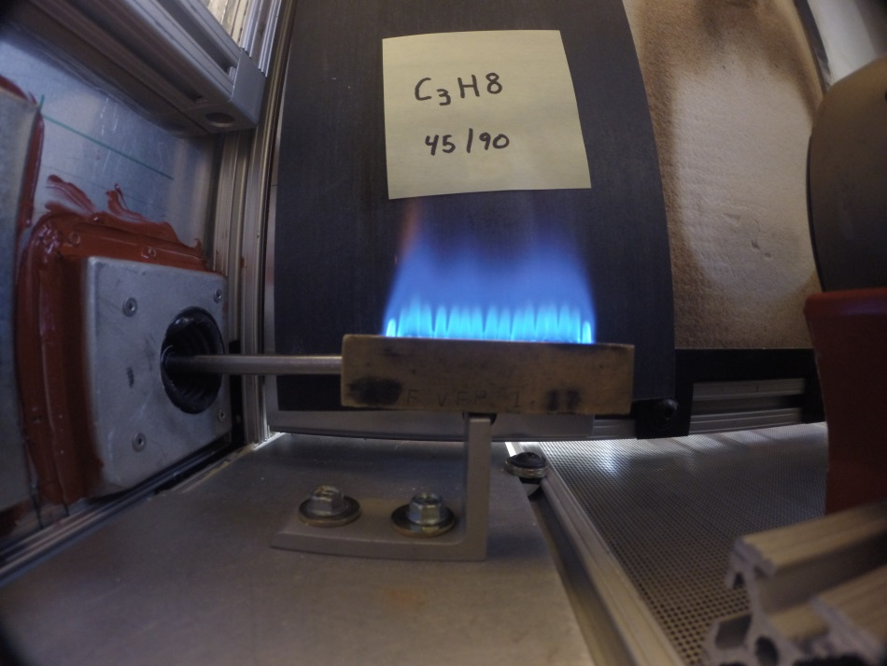
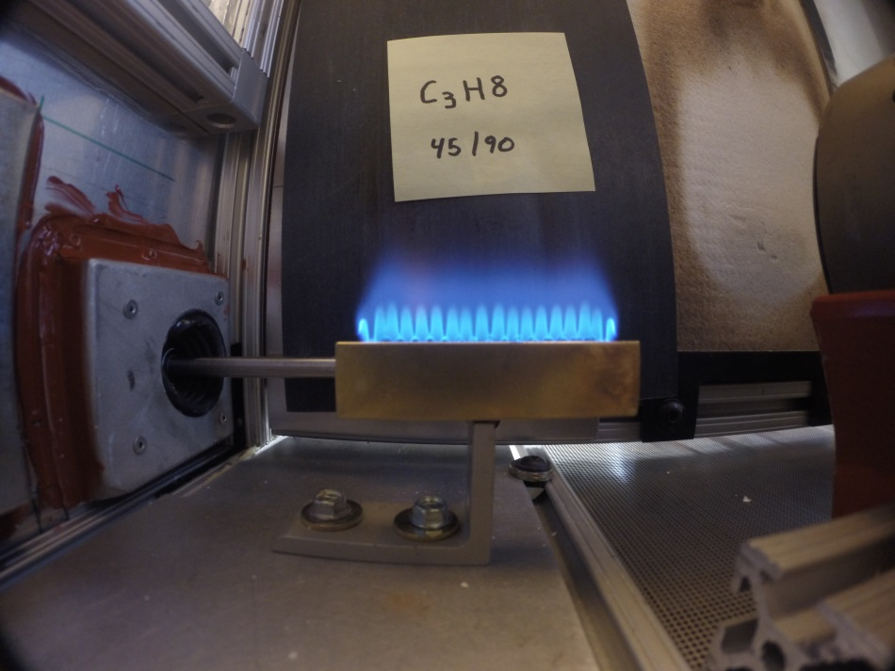
Development of Test
Ribbon Burner Comparison
Gen 1 Ribbon Burner
Marlin Burner

Slide 8
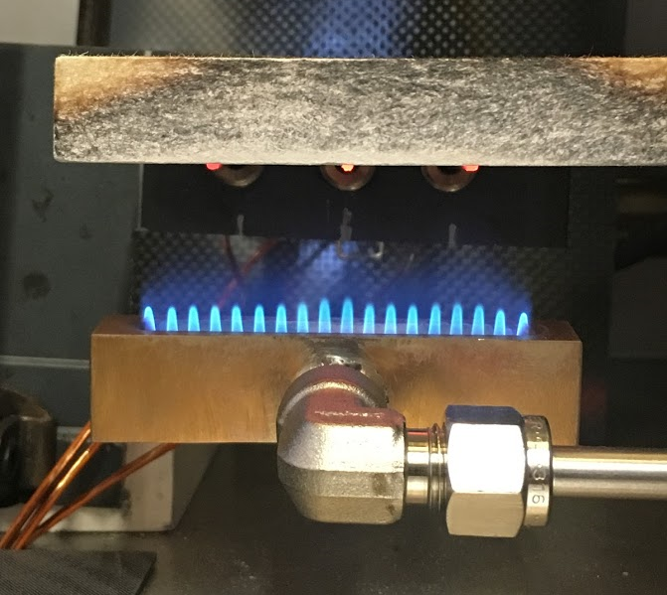
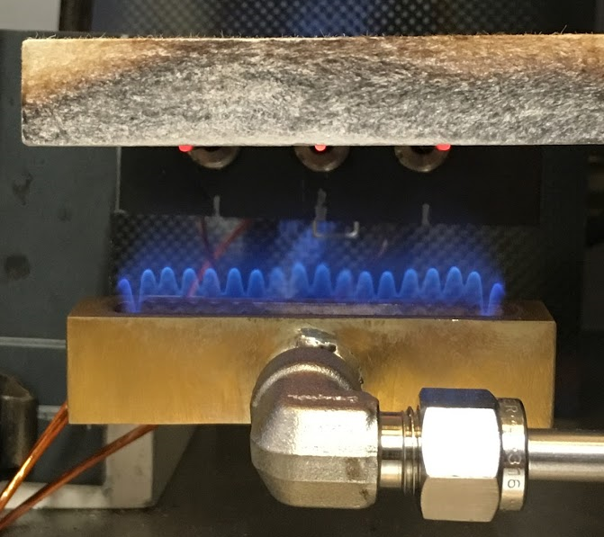
Development of Test
Fuel Comparison
Propane
Methane

Slide 9
Development of Test
Fuel Comparison
Propane
Methane

Slide 10
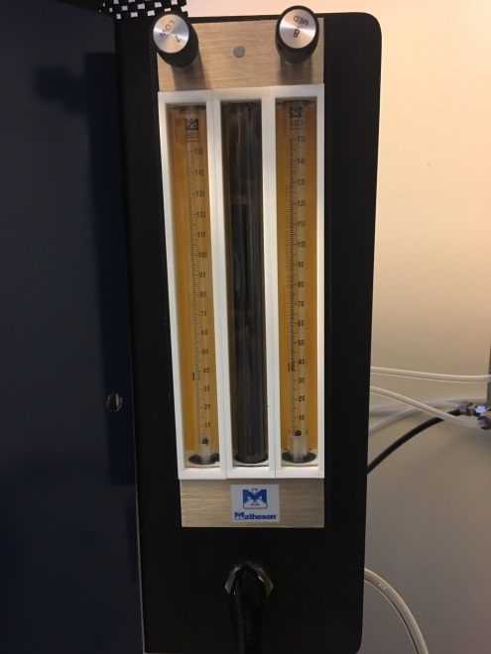
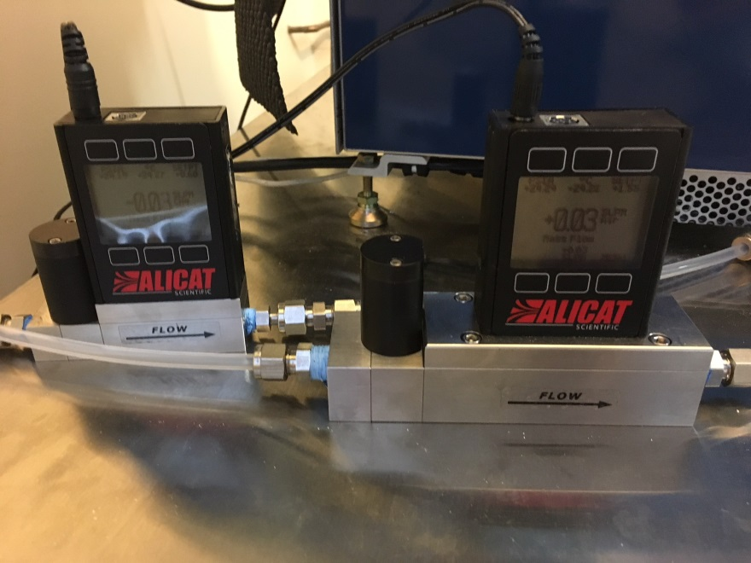
Development of Test
Mass Flow Control
Mass Flow Controllers replaced the mixer rotameter.
With requirements:
The mass flow controllers must be calibrated to the standard temperature and pressure conditions of 25°C and 14.6959 PSIA.
If they are not, the new flows must be calculated to match.
The methane to air ratio is determined to be 0.66/3.6 slpm.
Notes:
Until now we have referenced our fuel flows such as 45/90, 80/80 or 100/100 etc. These numbers come from the rotometer world where flows were are measured in a 150mm long tube with a glass float. The numbers corresponded as a measurement of that tube. These values then had conversion factors to a flow correcting for gas weight, temp and pressures. Obviously there is a cost increase to go this route, however we feel the benefit of accuracy is worth it in the end. Ultimately, we don’t have exact flow rates yet as more work remains to be done with the mass flow controllers.

Slide 11
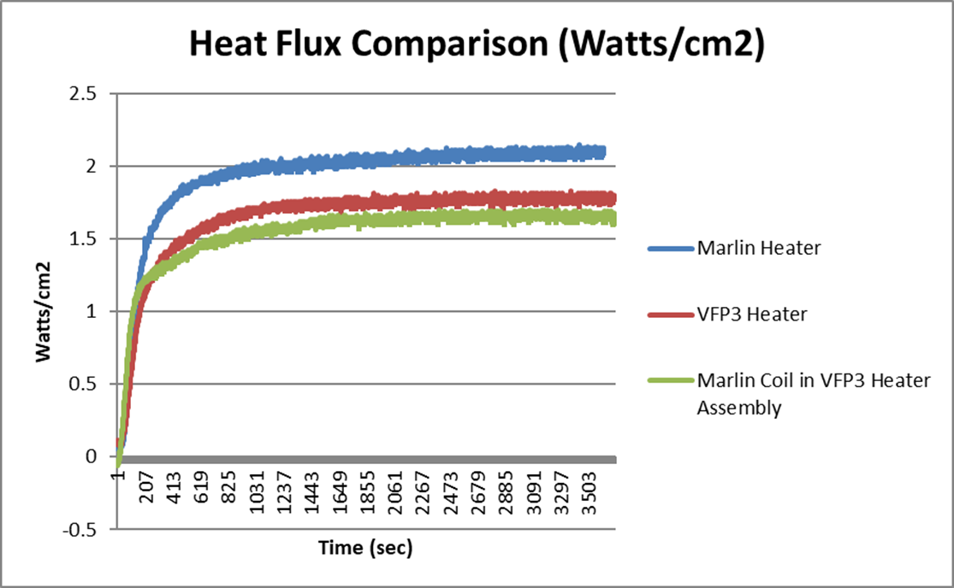
Development of Test
Heat Flux Comparison with Varying Heaters

Slide 12
Heater vs No Heater Testing
Heater Off, Cold Chamber
Burn Length (inch) | After Flame (seconds) | Chamber Temperature (°C)
0.44 | 3 | 16
0.62 | 6 | 16
0.54 | 4 | 17
Heater On, Hot Chamber (Regular style testing)
Burn Length (inch) | After Flame (seconds) | Chamber Temperature (°C)
4.07 | 92 | 65
4.09 | 88 | 69
4.45 | 79 | 72
Heater Off and taken out of chamber, Hot Chamber
Burn Length (inch) | After Flame (seconds) | Chamber Temperature (°C)
0.52 | 10 | 61
0.81 | 21 | 57
0.52 | 4 | 54

Slide 13
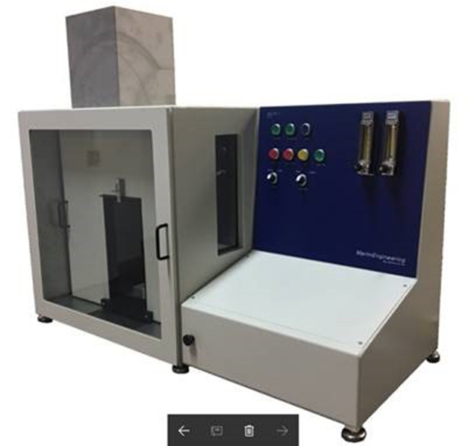
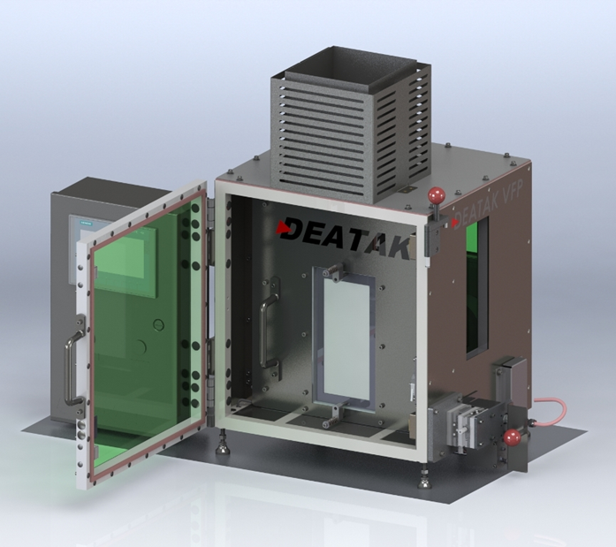
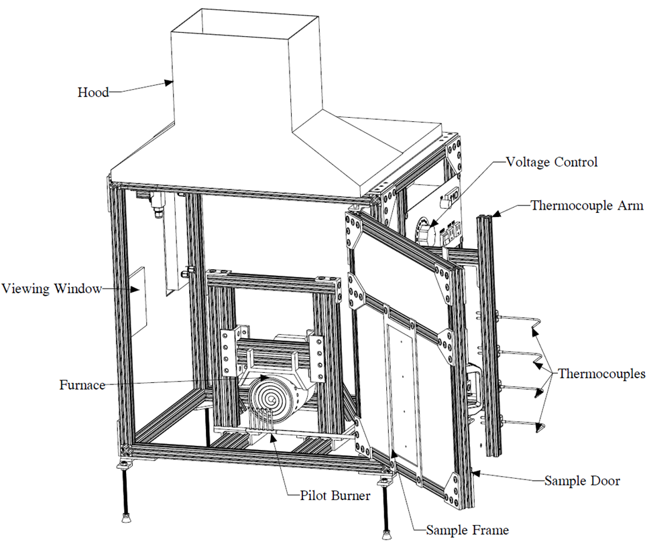

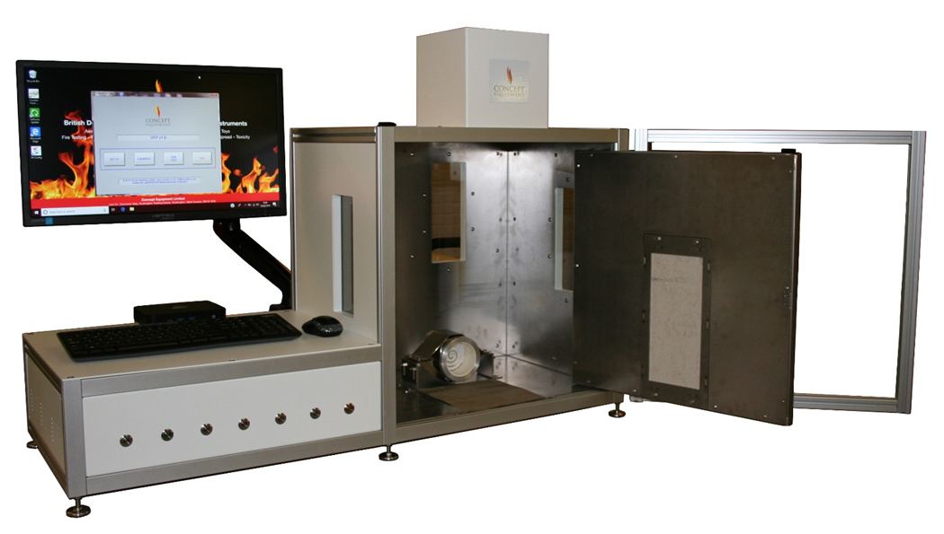
VFP Commercial Units
Marlin Engineering Inc.
Deatak
Concept Equipment Ltd

Slide 14

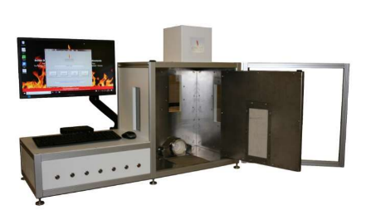
Building a Heater with Industry
Because all heaters will be inherently different, a joint FAA/industry meeting was held to design a uniform radiant heater
Developing a calibration method using a heat flux gauge
FAA and Manufacturers agreed on specifications for this uniform heater
FAA is currently establishing tolerances for the incident heat flux
Concept Equipment Ltd.
Deatak
Marlin Engineering

Slide 15
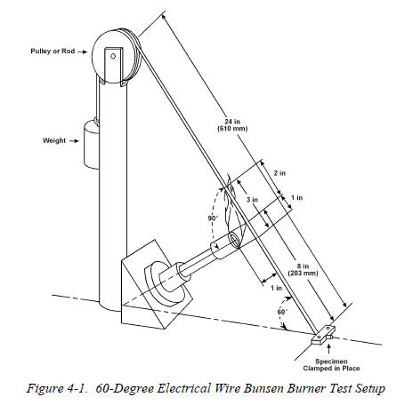
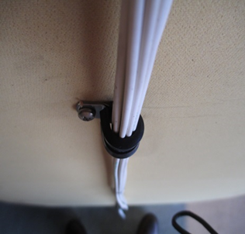
Development of Test
Wiring
The current 60-degree Bunsen burner test does not adequately screen poor performing materials
The current test also is:
  Not a good real-world representation
  Does not accommodate bundles

Slide 16
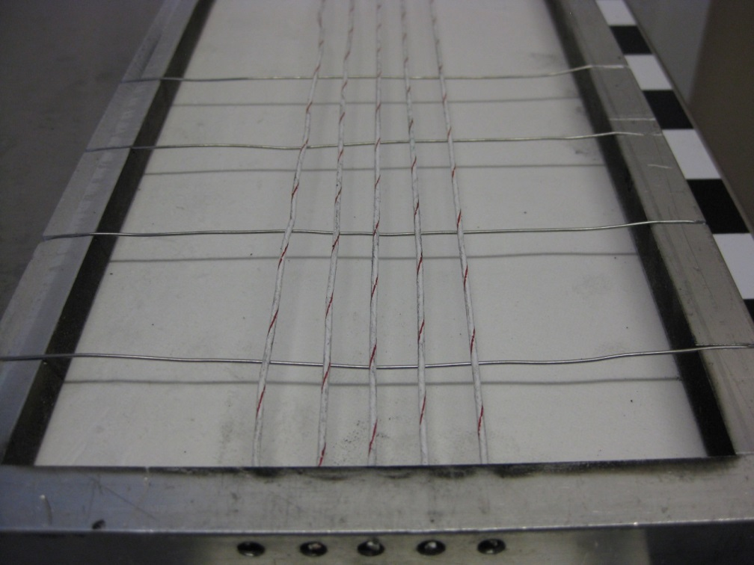
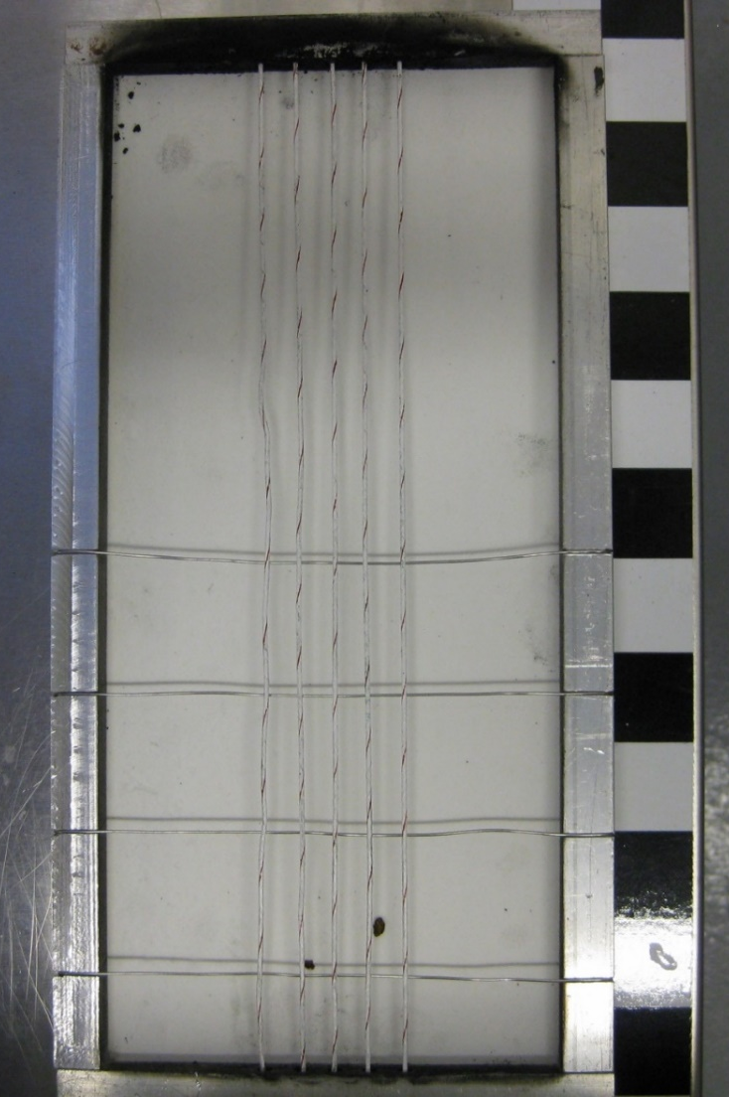
Development of Test
Wire Sample Holders
Wires are mounted 3/8 inch apart and held taut with stainless steel safety wire
Tested with 3 wires now

Slide 17
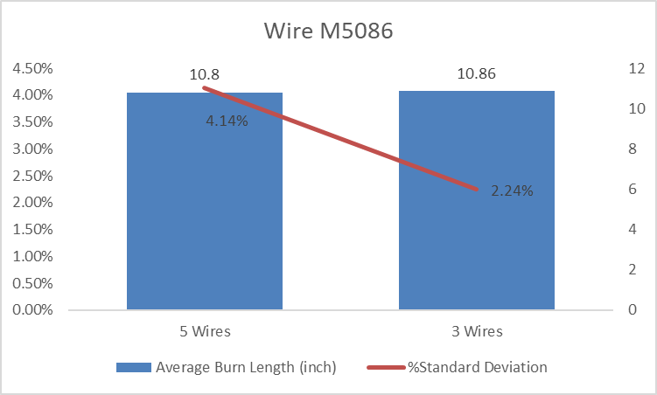
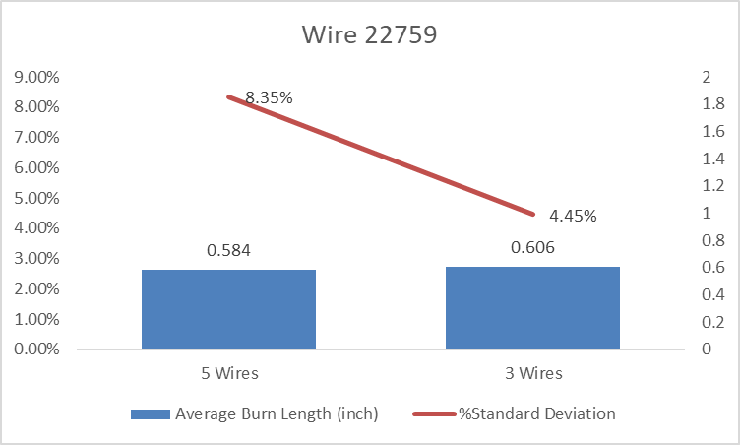
Development of Test
Wiring – 5 Wire vs 3 Wire Test
Testing has been done to show that the VFP tests were more repeatable when testing with 3 wires than with 5.
Two examples are shown below. Each test is an average of 5 runs.

Slide 18
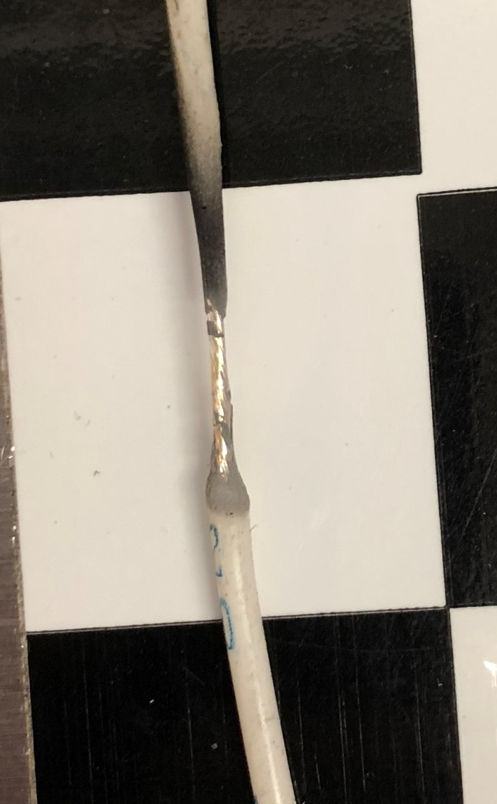
Measuring Burn Length in Wires
The burn length is measured where the insulation is consumed and wire is exposed
Of the 3 wires tested next to each other, the longest burn length is recorded for the test

Slide 19
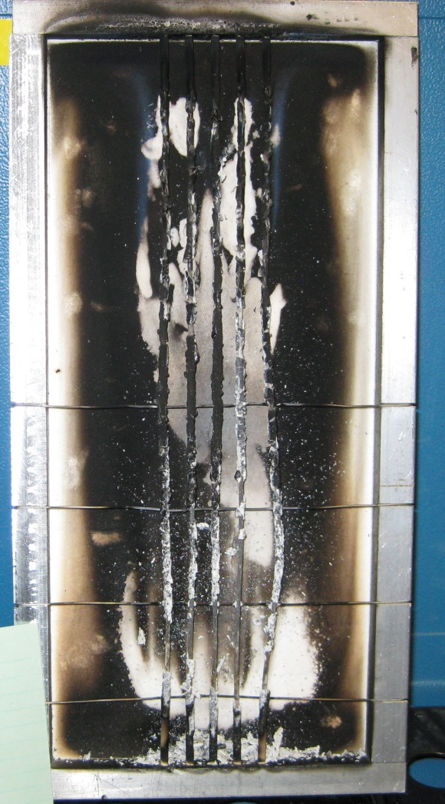
Comparing New Test to Bunsen Burner Test
Wire M81044
  Bunsen Burner Test burn length = 1.93 in.
  New VFP burn length = 9.75 in.
    With an average after flame of 1min 54 sec

Slide 20
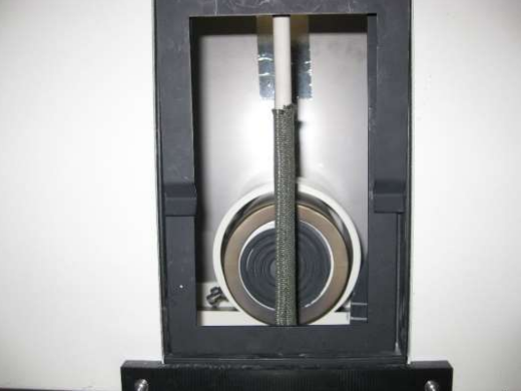
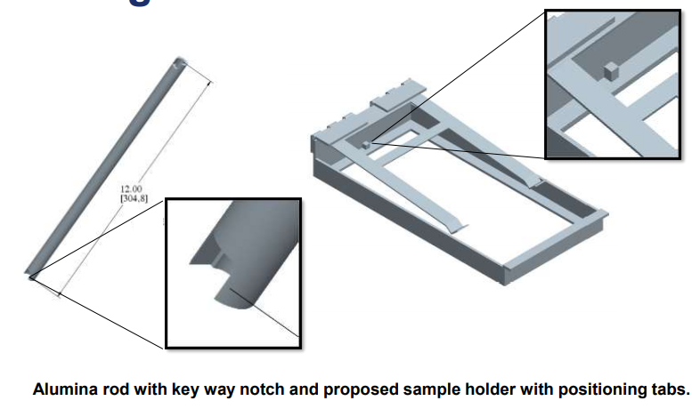
Sleeving
Appropriate Method to Test?
Securing samples during testing
  Alumina substrate
Sample holder accommodates wraps and tube type
Still in development

Slide 21
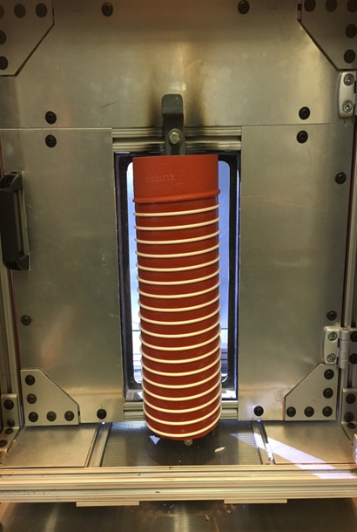
Ducting
Testing ducts: test flat or round?
Various possible methods to test ducts
  Sample sizes (various diameters)
  Geometric constraints
  Ducts with coils

Slide 22
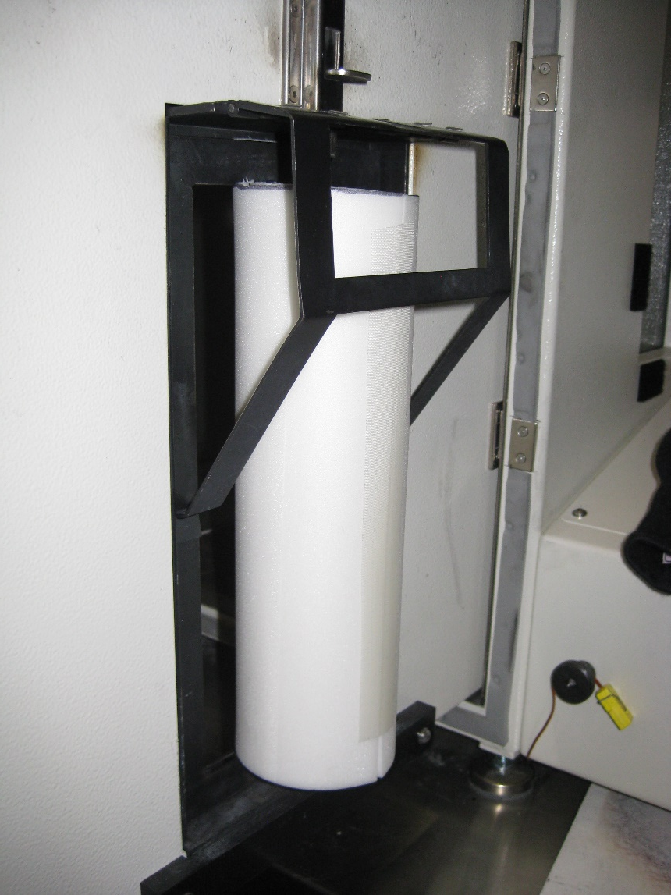
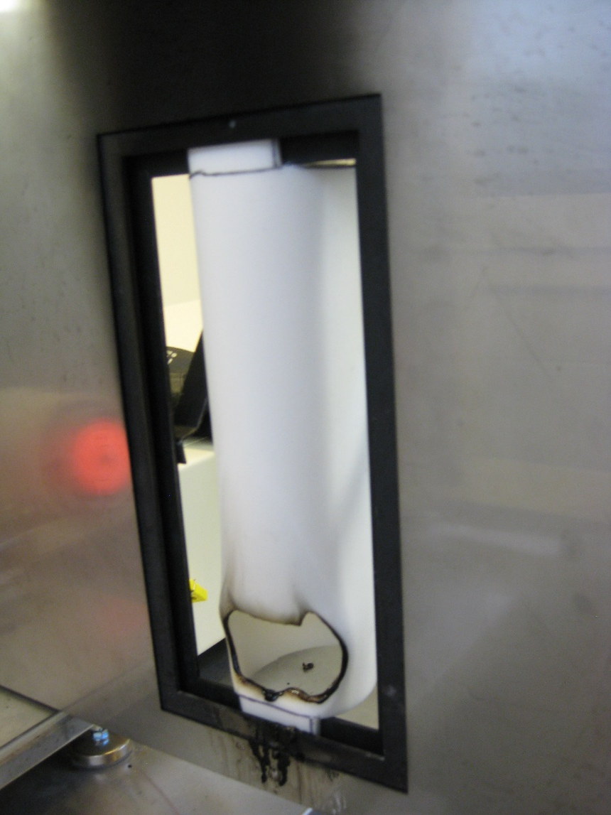
Testing Round Ducts

Slide 23
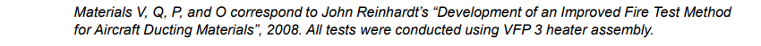
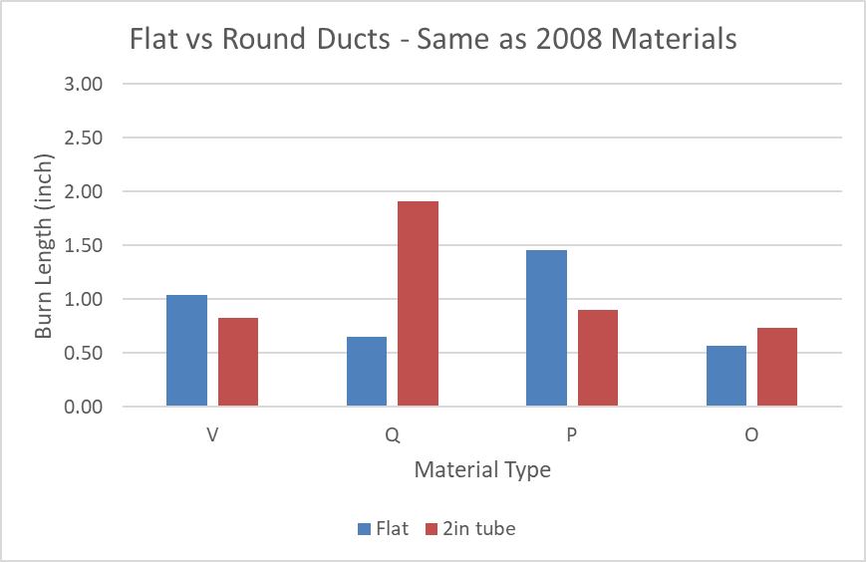
Flat vs Round Duct Testing
Depending on the material type the flat sample may or may not burn longer than the round
Material Q was not a round duct but a 2 inch square cross section

Slide 24
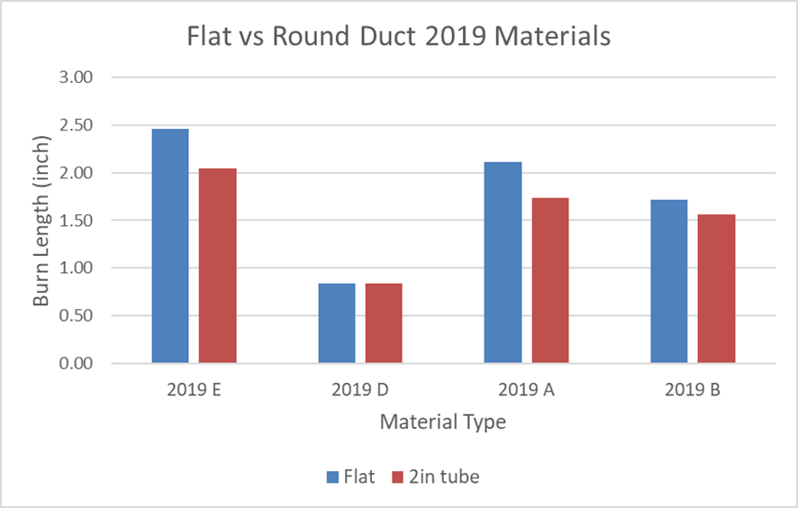
Flat vs Round Duct Testing
For the second set of materials, the flat burned longer than the round
This still is determined by the material type
Because of the differences, a test guideline will need to be chosen for uniformity

Slide 25
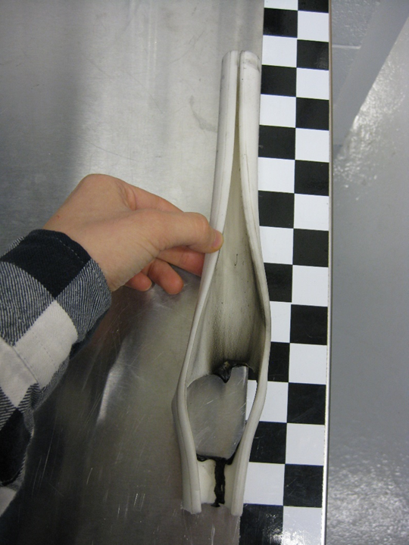
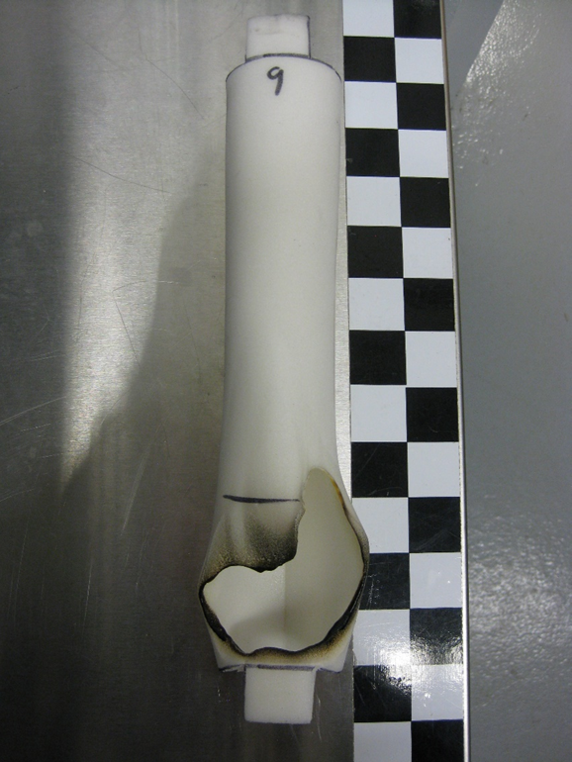
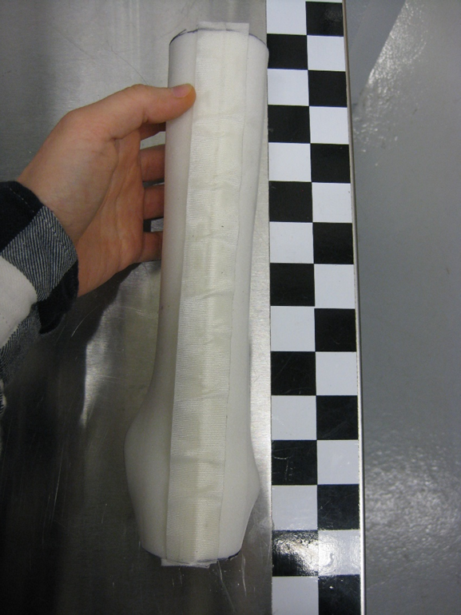
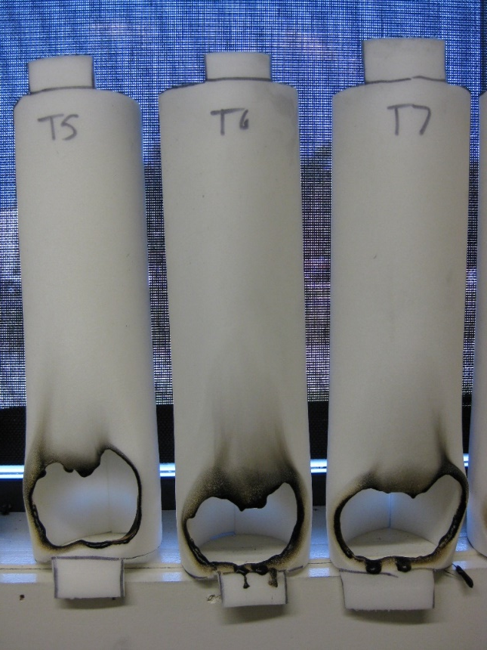
Comparison of Different Diameter Tubes
Open slit 1” Diameter tube
2.44 inch burn length
5.6% Standard Deviation
2 inch Diameter tube
1.75 inch burn length
20% Standard Deviation
3 inch Diameter tube
2.0 inch burn length
8.1% Standard Deviation

Slide 26
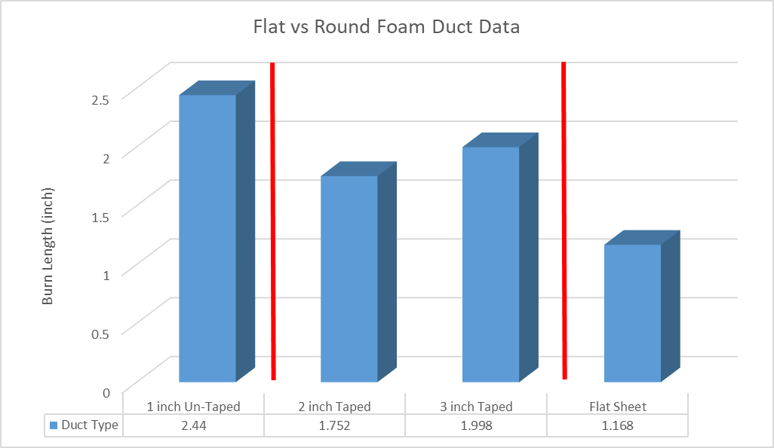
Comparison of Different Diameter Tubes
The 1-inch diameter duct is not comparable to the other two because the backs were not taped closed
The larger diameter 3-inch duct had a slightly higher burn length than the 2-inch diameter duct
The 4-inch diameter duct could not be tested because the material clogs the ribbon burner during testing, voiding the test.

Slide 27
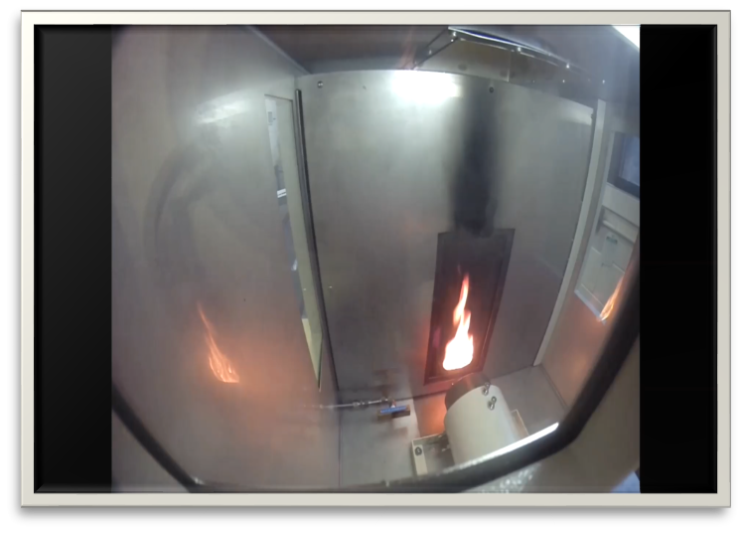
Comments or Questions?
Tina Emami
William J Hughes Technical Center
Bldg 275, ANG-E212
Atlantic City, NJ 08405
(609)-485-4277
Tina.Emami@faa.gov
Rick Whedbee
William J Hughes Technical Center
Bldg 275, ANG-E212
Atlantic City, NJ 08405
(609)-485-4610
Rick.Whedbee@faa.gov

